Slide 1
What Story Sells?
How Tourism Shapes Historical Memory
Hashima Island (Gunkanjima) — Nagasaki, Japan
Simulating Silence · SOAS University of London · simulating-silence.org
Notes:
Title slide. Do not reveal any details about the island yet. The next slide is a mystery image.

Slide 2
Photo: Crow Mountain Design / Shutterstock.com. Used under licence.
What is this place?
Simulating Silence · SOAS University of London · simulating-silence.org
Notes:
STARTER (5 minutes). Show this image without revealing the name. Ask: 'What do you think this place is? What clues can you see?' Take 3-4 suggestions. Students often guess: abandoned city, prison, warship, film set. All are reasonable — that ambiguity is the point. Do NOT reveal the name yet.

Slide 3
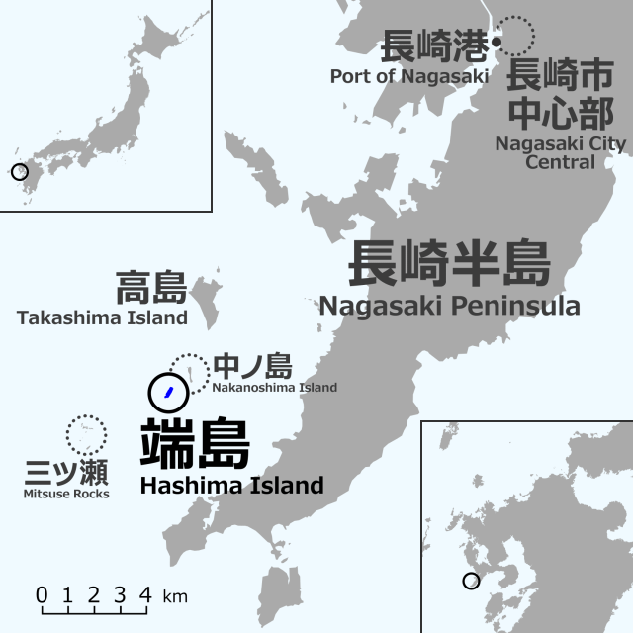
This is Hashima Island
Also called "Battleship Island" (Gunkanjima)
Location:
18 km off the coast of Nagasaki, Japan
Size:
6.3 hectares (~9 football pitches)
Population:
Over 5,000 people at its peak
Active:
1890–1974 (coal mine)
UNESCO:
World Heritage Site since 2015
[ Insert: hashima-location-map.jpg
(reclamation diagram) ]
Hisagi (氷鷺) - Own work, CC BY-SA 3.0, https://commons.wikimedia.org/w/index.php?curid=6653160
Simulating Silence · SOAS University of London · simulating-silence.org
Notes:
REVEAL. After students have guessed, show this slide. Read out the key facts. Emphasise the size: 6.3 hectares is roughly the size of 9 football pitches — and 5,000 people lived there. The reclamation diagram shows how the island was artificially expanded. This is an engineered environment, not a natural one.

Slide 4
Your Task
1. Read your assigned source on the source sheet
2. Complete your column of the comparison grid
3. Be ready to report back to the class
Source Sheet: simulating-silence.org/teach/secondary/sources/
Simulating Silence · SOAS University of London · simulating-silence.org
Notes:
PHASE 1 (15 minutes). Distribute the source sheet and the comparison grid worksheet. Assign one source per pair (or let students choose). Each pair reads their source and fills in their column of the grid. Circulate and prompt: 'What words does your source use? Who made it? Why?' If using the supported grid (3 sources), pairs work on B, D, and L only.

Slide 5
The Five Sources
B
Japan National Tourism Organization
Government tourism body
C
Nagasaki City Official Tourism Site
Local government
D
GaijinPot Travel Guide
Website for foreigners in Japan
I
Yamasa Shipping (tour operator)
Commercial boat tour company
L
Gunkanjima Digital Museum
VR museum, school trip programme
Simulating Silence · SOAS University of London · simulating-silence.org
Notes:
Reference slide for teacher use during Phase 2 reporting. You don't need to show this to students — it's here so you can track which source each pair is reporting on and prompt follow-up questions.

Slide 6
What did you find?
 | Source B | Source C | Source D | Source I | Source L
Who made it?
Who is it for?
Key words?
Mentions forced labour?
Fill in as each pair reports back
Simulating Silence · SOAS University of London · simulating-silence.org
Notes:
PHASE 2 (10 minutes). Each pair reports their findings. Fill in the grid on the whiteboard (or use this slide as a visual prompt). The key discovery: 4 of 5 sources don't mention forced labour at all. Source D mentions it but tells visitors not to ask. All five sources want the reader to visit, book, or buy something. Ask: 'What pattern do you notice?'

Slide 7
If a tourist visits Hashima using only these five sources to prepare...
What would they learn about the island's history?
And what would they never find out?
Simulating Silence · SOAS University of London · simulating-silence.org
Notes:
PHASE 3 — THE KEY QUESTION (5 minutes). Read this question aloud. Give students 1 minute in pairs, then take 2-3 responses. Listen for students who notice that the ABSENCE of information is as significant as its presence. The forced labour history isn't hidden behind a paywall — it's simply not mentioned. That's the lesson.

Slide 8
Interpretive Framing
The way a source selects, organises, and presents information to create a particular understanding of events — even when everything it says is factually accurate.
Exit Ticket
How can a source be accurate but still misleading?
Write your answer in one or two sentences.
Simulating Silence · SOAS University of London · simulating-silence.org
Notes:
PLENARY (10 minutes). Introduce the concept of 'interpretive framing.' Read the definition. Then pose the exit ticket question. Students write their answer on paper or on the back of their worksheet. This is the key assessment moment — see the assessment descriptors in the lesson plan for Emerging/Developing/Secure responses.

Slide 9
Extension / Homework
Option A — Creative
Option B — Analytical
Write the text for a new tourism webpage about Hashima — one that tells the full history. What would you include that the five sources left out?
Choose a heritage site or museum you have visited. Identify three things the site chose to include and three things it chose to leave out. Explain how these choices shape a visitor's understanding.
Simulating Silence · SOAS University of London · simulating-silence.org
Notes:
Extension/homework options. Option A is creative and accessible to all students. Option B is analytical and suits higher-attaining students. Both can be set as homework. The lighthouse image is from Hashima — one of the few structures still maintained on the abandoned island.

Slide 10
One more thing...
The official Hashima heritage website describes the island's entire history — its coal mine, its community, its technological innovations.
It does not mention forced labour.
The site footer reads: "Directed by Koko Kato."
Source A: japansmeijiindustrialrevolution.com
Image credits: Battleship silhouette: kntrty / Flickr, CC BY 2.0. Reclamation diagram: Public domain, Wikimedia Commons.
Simulating Silence · SOAS University of London · simulating-silence.org
Notes:
CLOSING (if time). This slide introduces Source A — the official heritage website — as a bridge to future lessons. If students have time, let them visit the URL. Ask: 'Is this source accurate? Is it complete? What's the difference?' This sets up the GCSE lesson on contested heritage if you choose to run it.

