Slide 1
Who Gets to Tell the Story?
Hashima Island and Contested Heritage
AQA GCSE History — Source Analysis Skills
Simulating Silence · SOAS University of London · simulating-silence.org
Notes:
Title slide. This lesson builds GCSE source analysis skills using contested heritage as the case study.

Slide 2
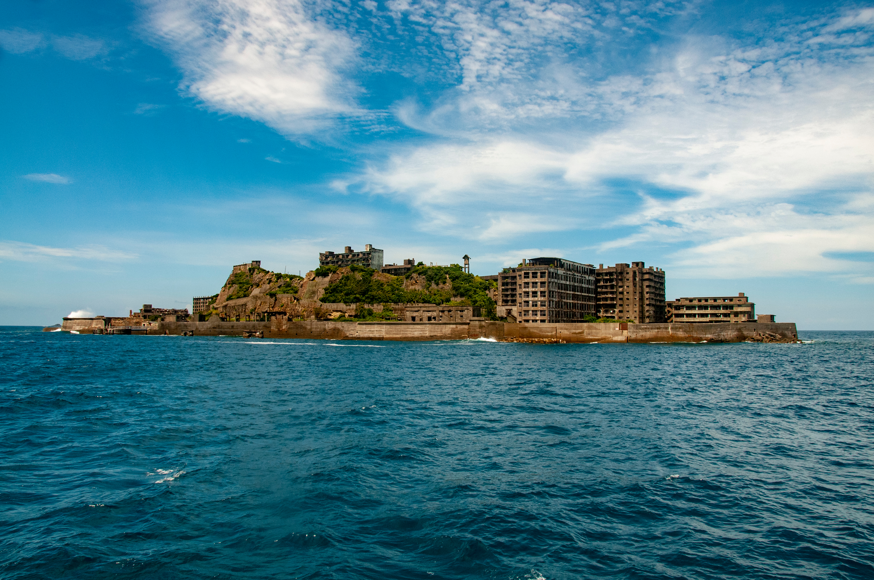
Hashima Island — The Basics
Coal mine operated 1890–1974
Over 5,000 residents on 6.3 hectares
UNESCO World Heritage Site (2015)
Japan promised to tell the "full history"
[ Insert: hashima-battleship-silhouette.jpg ]
Photo: Zoblinski / Shutterstock.com. Used under licence.
Simulating Silence · SOAS University of London · simulating-silence.org
Notes:
Brief orientation (2 minutes). If students did the KS3 lesson, this is revision. If not, give them the essential context: small island, coal mine, 5,000 people, UNESCO World Heritage Site. The key new information for GCSE: Japan made promises to UNESCO in 2015 about telling the 'full history.' This lesson examines what happened next.

Slide 3
Could these be about the same place?
Source ?
Source ?
"Japan's first large-scale undersea coal extraction ... technological innovation ... extraordinary community life."
"Island of hell ... 500 to 800 Koreans worked as forced labourers ... 122 Koreans are confirmed to have died."
Discuss with your partner: Are both of these accurate?
Simulating Silence · SOAS University of London · simulating-silence.org
Notes:
STARTER (5 minutes). Show the two excerpts WITHOUT labels. Ask: 'Could these be describing the same place?' Let students discuss in pairs for 1 minute, then take responses. The contrast should be striking — one celebrates industrial achievement, the other describes forced labour and death. Both are about Hashima.

Slide 4
Both describe Hashima Island.
Why do these accounts differ so radically?
Source A
Official heritage website
Managed by the NCIH
Source G
Korea.net — South Korean
government news site
Today: you will trace the connections between these sources and the institutions behind them.
Simulating Silence · SOAS University of London · simulating-silence.org
Notes:
REVEAL. Both describe Hashima Island. Source A is the official heritage website (managed by Kato Koko and the NCIH). Source G is the Korean government's response. The question is not 'which one is right?' but 'why do these accounts differ so radically?' This frames the entire lesson.

Slide 5
Phase 1: Paired Source Analysis
Pair 1
Sources E + F
UNESCO decision (2015) vs. UNESCO criticism (2021)
Pair 2
Sources A + K
Official heritage site vs. 'Truth of Gunkanjima'
Pair 3
Sources G + K
Korean government vs. NCIH counter-narrative
Use the analysis worksheet to record your findings for each source.
Simulating Silence · SOAS University of London · simulating-silence.org
Notes:
PHASE 1 (15 minutes). Distribute the source sheet and the analysis worksheet. Assign source pairs as shown. Each pair reads both sources and completes the analysis table. Circulate and prompt: 'What does Source X claim? What evidence does it give? What does it leave out?'

Slide 6
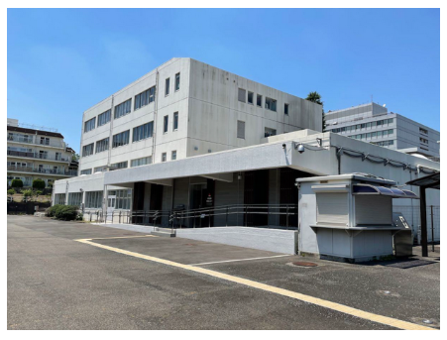
The Institutional Connection
Source A
Source K
IHIC
Official heritage
website
"Truth of
Gunkanjima"
Information Centre
(Source F)
All managed by the same person and organisation
National Congress of Industrial Heritage (NCIH)
Managing Director: Katō Kōko
[ IHIC image ]
Simulating Silence · SOAS University of London · simulating-silence.org
Notes:
PHASE 2 (10 minutes). This is the pivotal moment. Distribute the Source N extract (Johnsen article). Give students 3 minutes to read it, then reveal this slide. The key discovery: Sources A, K, and the IHIC (criticised by UNESCO in Source F) are all managed by the same person — Kato Koko — and the same organisation — the NCIH. This is not a conspiracy theory; it is publicly documented. But it is invisible to anyone who reads any single source in isolation.

Slide 7
Discussion
1
How does knowing the institutional connection change how you read Sources A and K?
2
Source K includes a disclaimer: its witnesses' memories 'may not always be accurate.' Does this make the source less useful — or more useful?
3
Can a source still be useful for a historian even if it was produced to support a particular agenda?
Simulating Silence · SOAS University of London · simulating-silence.org
Notes:
Phase 2 discussion (5 minutes). These three questions structure the discussion. Question 1 checks comprehension. Question 2 pushes analysis — students should recognise that knowing the institutional connection changes how they evaluate each source's claims. Question 3 is the hardest: a source created to support an agenda can still be useful as EVIDENCE OF THAT AGENDA. This is a key GCSE skill.

Slide 8
Phase 3: Exam-Style Question
AQA-style 8-mark question
How useful are Sources A and G for an enquiry into how governments use heritage sites to shape historical memory?
Explain your answer using Sources A and G and your knowledge of how heritage sites present the past.
Sentence starters (if needed):
"Source A is useful because it reveals..."
"However, Source A is limited because..."
"Source G is useful for a different reason..."
"When we consider both sources together..."
15 minutes — write in continuous prose
Simulating Silence · SOAS University of London · simulating-silence.org
Notes:
PHASE 3 (15 minutes). This is the timed writing task. Display the question. Distribute sentence starters to students who need them. Students should write in exam conditions: continuous prose, no bullet points. Circulate and check students are using BOTH sources and linking to their knowledge of heritage sites.

Slide 9
Sources are not neutral containers of information.
Every digital source was created by someone, for a purpose, within an institutional context.
The skill is not finding the 'right' source.
It is understanding what each source is doing and whose interests it serves.
Simulating Silence · SOAS University of London · simulating-silence.org
Notes:
PLENARY (5 minutes). Read the key concept statement. Then ask students to share one thing they will look for next time they visit a museum or heritage site. The goal is to make the analytical skills from this lesson transferable — not just about Hashima, but about any contested heritage site.

Slide 10
Extension / Homework
Option A — Exam Practice
Option B — Research
Choose a British heritage site or museum (e.g. the British Museum, a National Trust property, a local war memorial). Write an AQA-style "How useful..." answer about two sources relating to that site.
Source K and Source A are both managed by the same organisation (the NCIH) and the same director. Read Source N (Johnsen, 2021 — Part 1 only) and write a paragraph explaining what this connection reveals about how heritage narratives are constructed across multiple platforms.
Simulating Silence · SOAS University of London · simulating-silence.org
Notes:
Extension/homework options. Option A is exam practice — students apply the same skills to a British heritage example they already know. Option B is research — students read Part 1 of the Johnsen article and trace the NCIH network across multiple platforms. Both develop transferable GCSE skills.

Slide 11
Mark Scheme — Teacher Reference
Level 4 (7–8)
Evaluates both sources with contextual knowledge. Analyses HOW and WHY each source presents its narrative. Considers what is absent as well as what is present. May reference institutional connections.
Level 3 (5–6)
Explains usefulness of both sources with supporting detail. Identifies purpose and audience. Begins to consider limitations and what each source does not say.
Level 2 (3–4)
Describes content of both sources. Identifies some differences. Makes basic comments about usefulness without sustained explanation.
Level 1 (1–2)
Identifies basic content from one or both sources. General comments about sources without specific reference to the material.
Simulating Silence · SOAS University of London · simulating-silence.org
Notes:
TEACHER REFERENCE — Mark scheme for the Phase 3 writing task. Aligned to AQA four-level structure. You can show this to students after they have completed their writing, or keep it hidden. The key discriminator between levels: Level 1 describes content, Level 2 explains usefulness, Level 3 evaluates with context, Level 4 synthesises across both sources.

Slide 12
Resources
Source Sheet:
simulating-silence.org/teach/secondary/sources/
Lesson Plan:
simulating-silence.org/teach/secondary/lessons/gcse-source-analysis/
Student Worksheets:
Analysis sheet + Sentence starters (PDF downloads)
Source N Extract:
Johnsen classroom extract (PDF download)
Full Johnsen Article:
apjjf.org/2021/23/johnsen (open access)
© 2023–2026 Christopher Gerteis. SOAS University of London.
Notes:
Final slide — resources and credits. All materials are freely available at simulating-silence.org. The source sheet, worksheets, and this slide deck can be downloaded and adapted for classroom use.

